Slide 1
SITE Reliability Engineering Training phase 1 – Dec 14to 23rd
Topics
S/W. Development Models
[ Agile, DevOps, DevSecOps]
SRE
Virtual Box, Vagrant, NGINX [ Linux]
Container - Dockers

Slide 2
Content [Module 3] Dec 21st – 23rd
Containers + Dockers

Slide 3


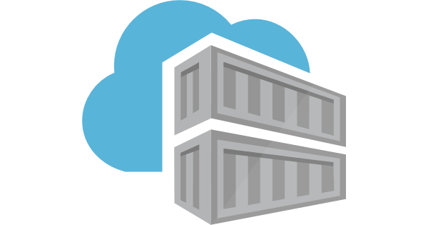
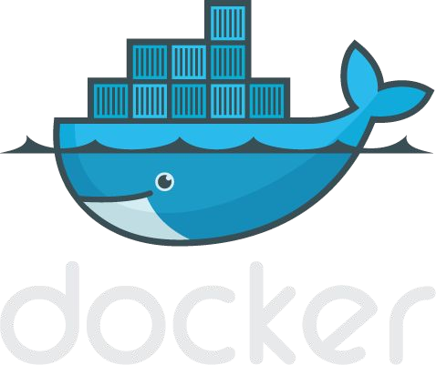
Introduction to Docker

Slide 4
Section 1: What is Docker
Basic Docker Commands Dockerfiles

Slide 5
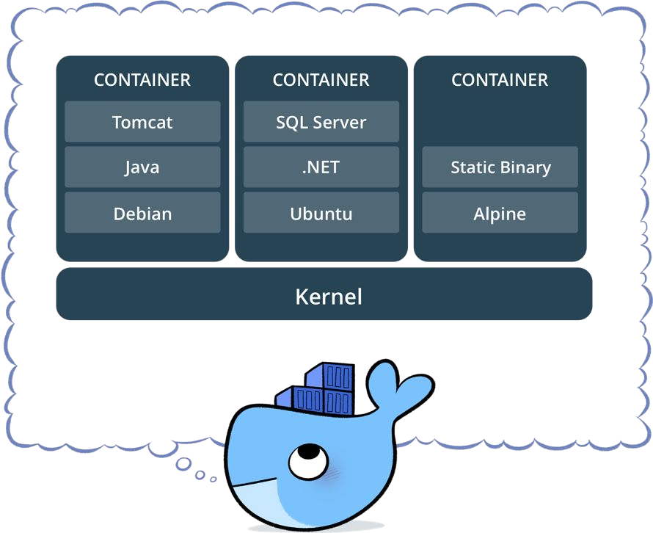
What is a container?
Standardized packaging for software and dependencies
Isolate apps from each other
Share the same OS kernel
Works for all major Linux distributions
Containers native to Windows Server 2016

Slide 6
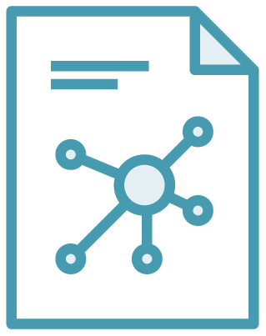

The Role of Images and Containers
Docker Image
Docker Container
Example: Ubuntu with Node.js and Application Code
Created by using an image. Runs your application.

Slide 7


Docker containers are NOT VMs
Easy connection to make
Fundamentally different architectures
Fundamentally different benefits
Virtual Machine
Container
7

Slide 8
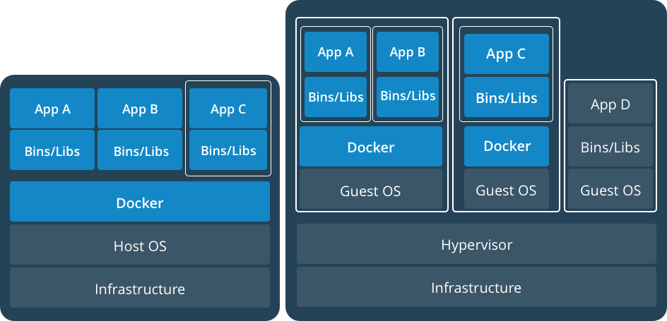
Docker Containers Versus Virtual Machines
App 1
App 2
Bins/Libs
Bins/Libs
Guest OS
Guest OS
App 1
App 2
Bins/Libs
Bins/Libs
Hypervisor
Docker Engine
Host Operating System
Host Operating System
Virtual Machines
Docker Containers

Slide 9
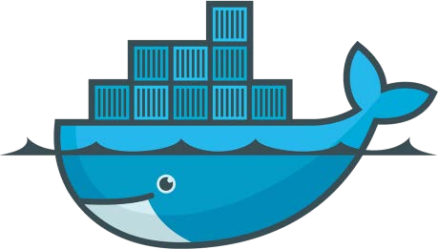
Lightweight, open, secure platform
Simplify building, shipping, running apps
What Is Docker?
Runs natively on Linux or Windows Server
Runs on Windows or Mac Development machines (with a virtual machine)
Relies on "images" and "containers"

Slide 10
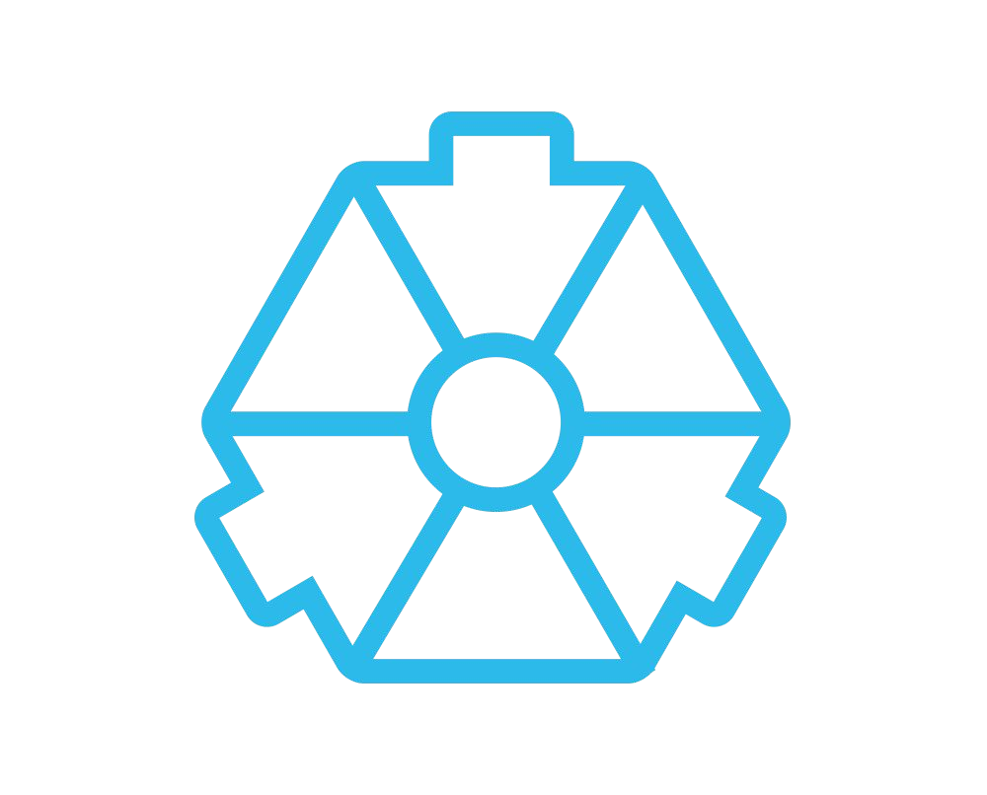
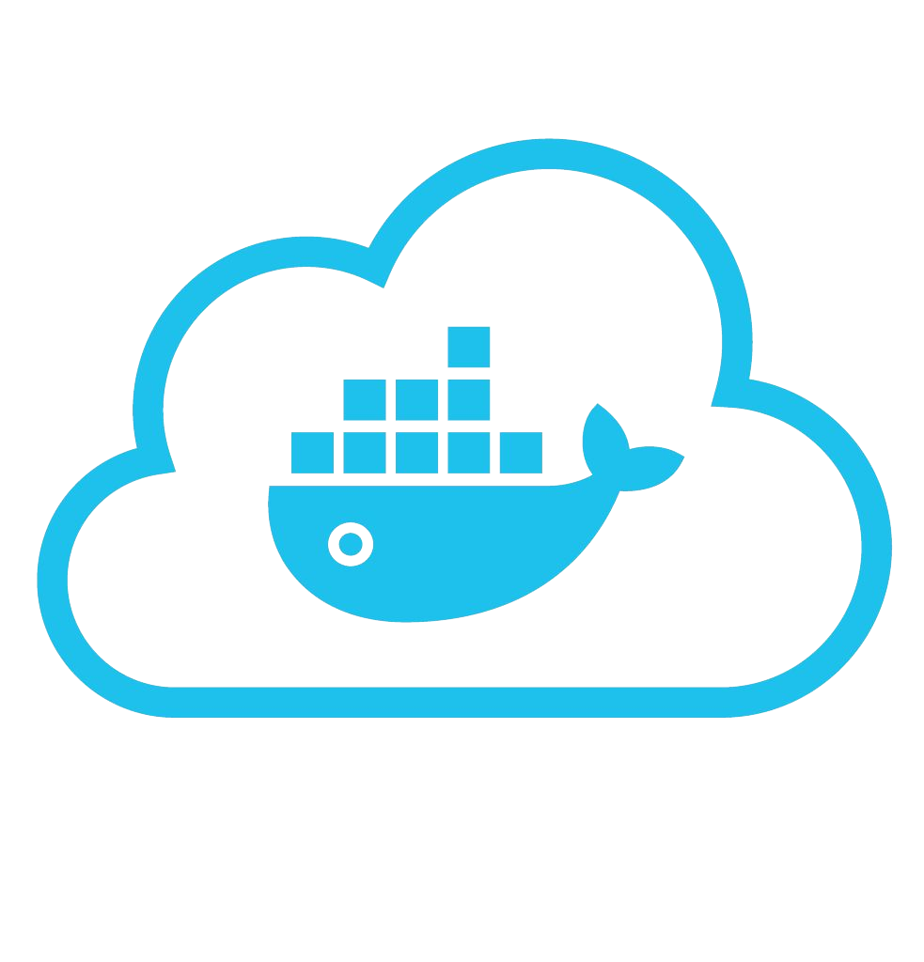
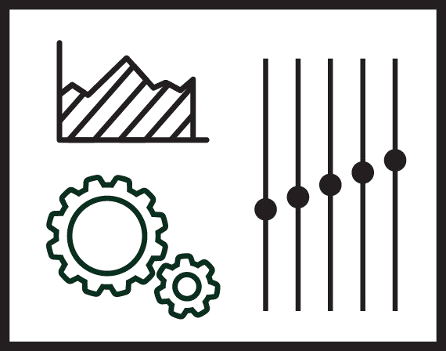









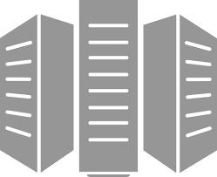



Using Docker: Build, Ship, Run Workflow
Developers IT Operations
BUILD
Development Environments
SHIP
Create & Store Images
RUN
Deploy, Manage, Scale

Slide 11




Some Docker Vocabulary
Docker Image
The basis of a Docker container. Represents a full application
Docker Container
The standard unit in which the application service resides and executes
Docker Engine
Creates, ships and runs Docker containers deployable on a physical or virtual, host locally, in a datacenter or cloud service provider
Registry Service (Docker Hub(Public) or Docker Trusted Registry(Private))
Cloud or server based storage and distribution service for your images

Slide 12
Basic Docker Commands
$ docker image pull node:latest
$ docker image ls
$ docker container run –d –p 5000:5000 –-name node node:latest
$ docker container ps
$ docker container stop node(or <container id>)
$ docker container rm node (or <container id>)
$ docker image rmi (or <image id>)
$ docker build –t node:2.0 .
$ docker image push node:2.0
$ docker --help

Slide 13
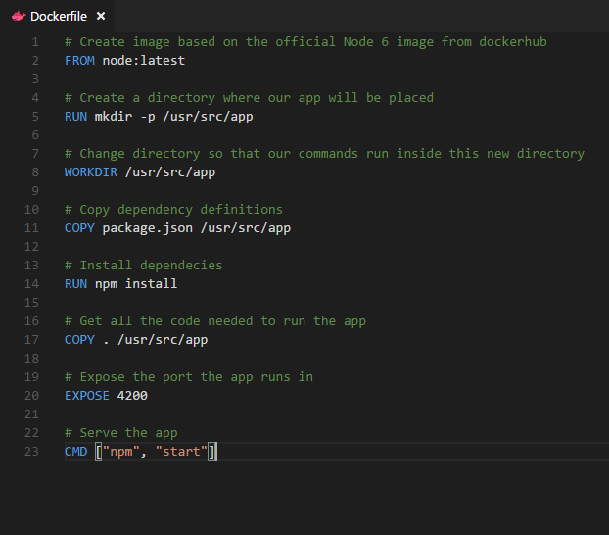
Dockerfile – Linux Example
Instructions on how to build a Docker image
Looks very similar to “native” commands
Important to optimize your Dockerfile
14

Slide 14
Section 2:
Anatomy of a Docker Container Docker Volumes
Volume Use Cases

Slide 15
Let’s Go Back to Our Dockerfile

Slide 16
Each Dockerfile Command Creates a Layer
…
EXPOSE
COPY
WORKDIR
RUN
FROM
Kernel

Slide 17
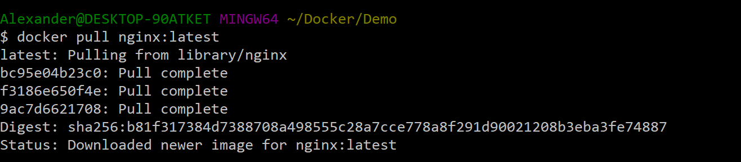
Docker Image Pull: Pulls Layers

Slide 18
Docker Volumes
Volumes mount a directory on the host into the container at a specific location
Can be used to share (and persist) data between containers
Directory persists after the container is deleted
Unless you explicitly delete it
Can be created in a Dockerfile or via CLI

Slide 19
Why Use Volumes
Mount local source code into a running container
docker container run -v $(pwd):/usr/src/app/ myapp
Improve performance
− As directory structures get complicated traversing the tree can slow system performance
Data persistence

Slide 20

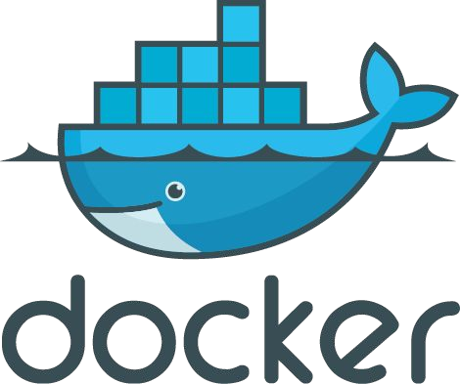
Section 3: Networking

Slide 21
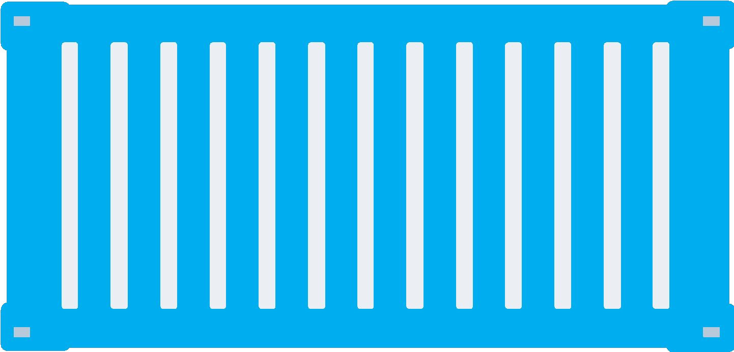
What is Docker Bridge Networking
Docker host
Docker host
Cntnr 1
Cntnr 2
Cntnr 3
Cntnr 4
Cntnr 5
Cntnr 6
Cntnr 7
bridgenet1
bridgenet2
bridgenet3
docker network create -d bridge --name bridgenet1

Slide 22


Docker Bridge Networking and Port Mapping
Docker host 1
Host port
Container port
Cntnr1
10.0.0.8
:80
$ docker container run -p 8080:80 ...
Bridge
172.14.3.55
:8080
L2/L3 physical network

Slide 23
Section 4: Docker Compose

Slide 24




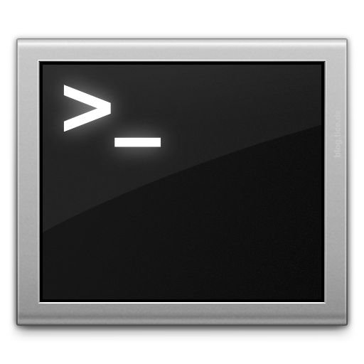







Docker Compose: Multi Container Applications
Build and run one container at a time
Manually connect containers together
Must be careful with dependencies and start up order
Define multi container app in compose.yml file
Single command to deploy entire app
Handles container dependencies
Works with Docker Swarm, Networking, Volumes, Universal Control Plane
49

Slide 25

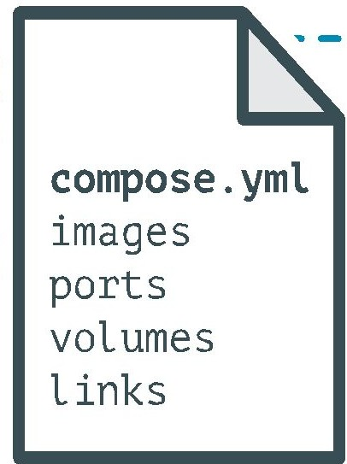
Docker Compose: Multi Container Applications
version: '2' # specify docker-compose version
# Define the services/containers to be run
services:
angular: # name of the first service
build: client # specify the directory of the Dockerfile
ports:
- "4200:4200" # specify port forewarding
express: #name of the second service
build: api # specify the directory of the Dockerfile
ports:
- "3977:3977" #specify ports forewarding
database: # name of the third service
image: mongo # specify image to build container from
ports:
- "27017:27017" # specify port forewarding

Slide 26
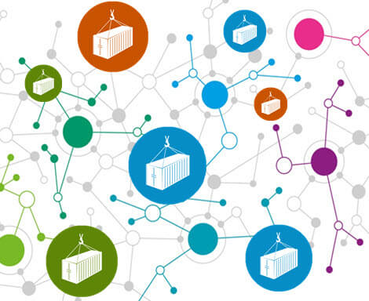
Docker Compose: Scale Container Applications

Slide 27
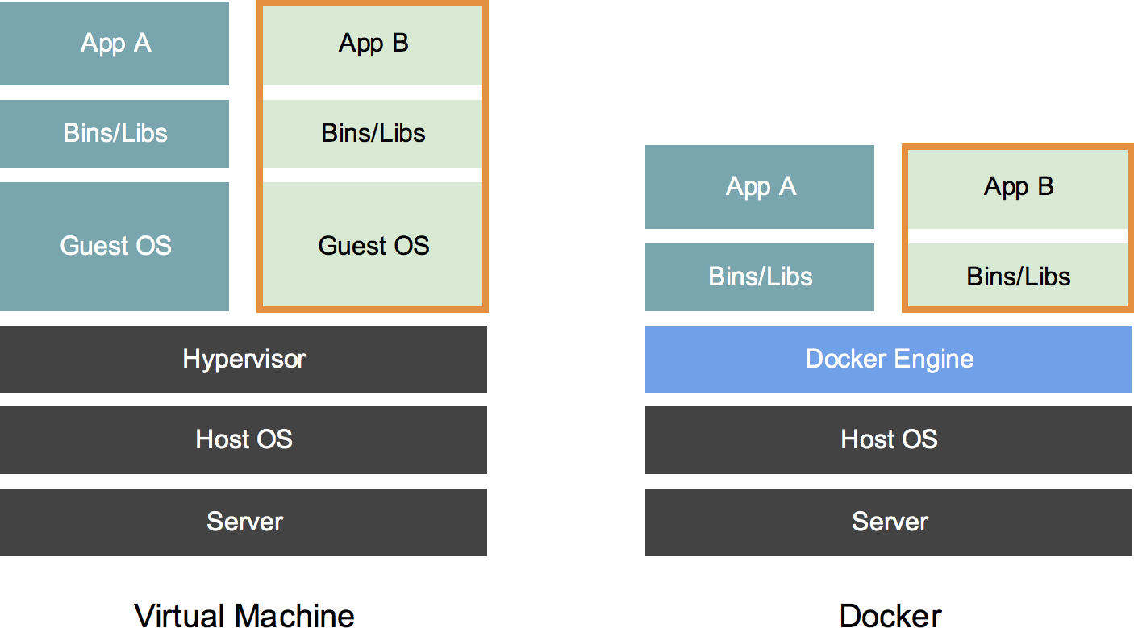
A lightweight virtualization for Applications Smaller than VM's
What is it?
Just the files needed to run the application
27 / 35

Slide 28
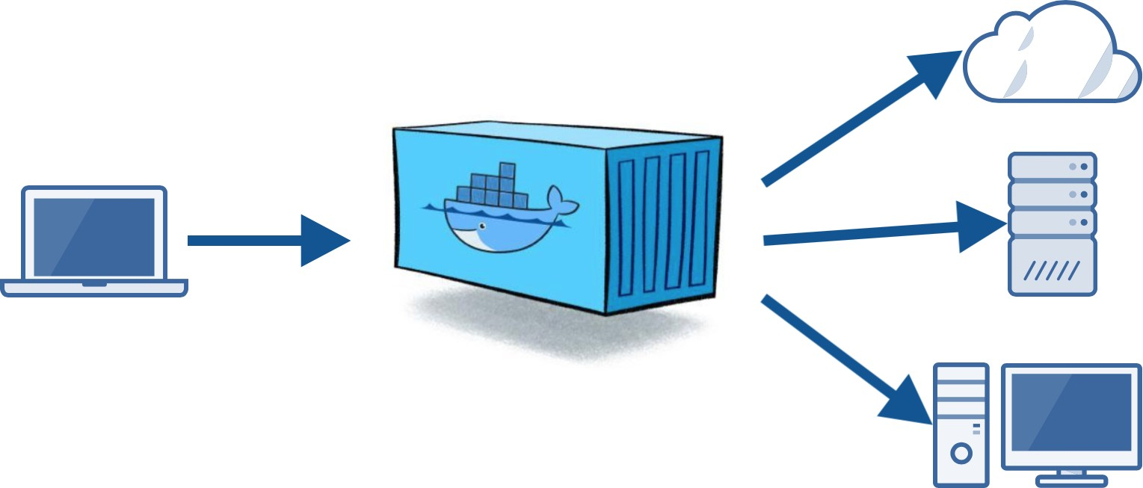
Why use it?
Build - Ship - Run
Reproducible development environment
Same container in dev, test and prod
Containers are versioned

Slide 29
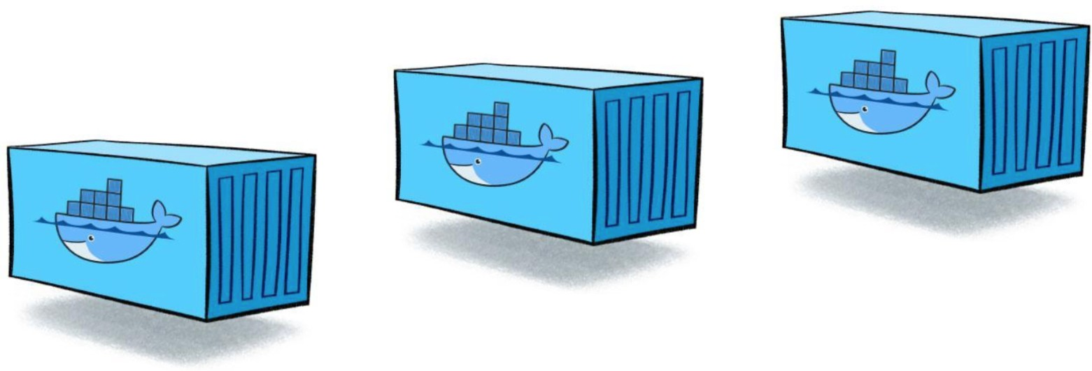
Namespaces
How does it work?
File System
Process IDs
Registry
Networking

Slide 30
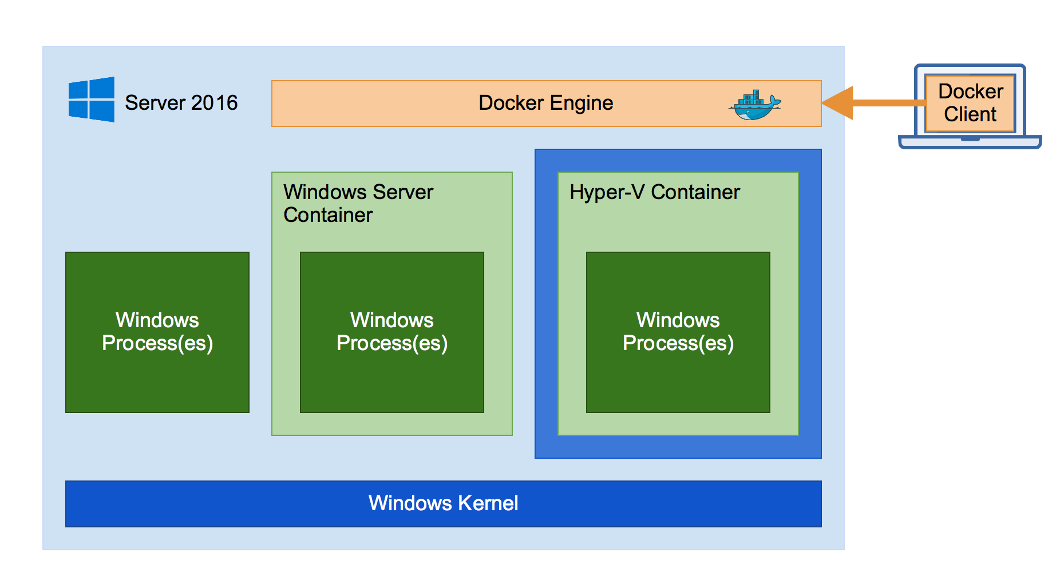
System architecture

Slide 31
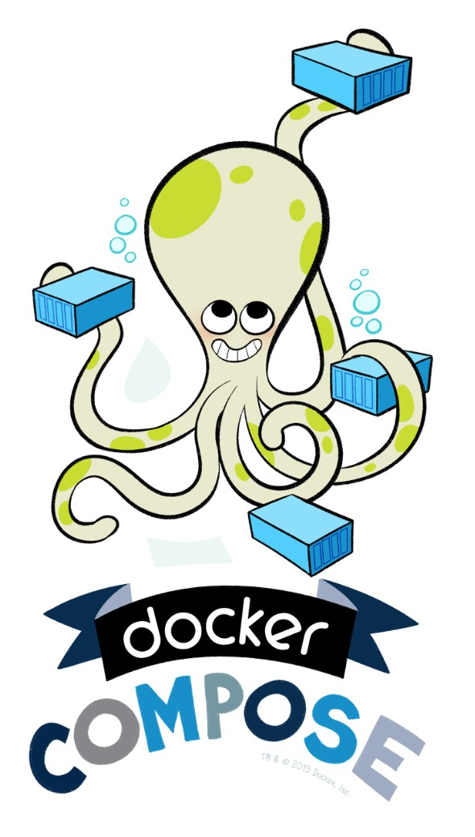
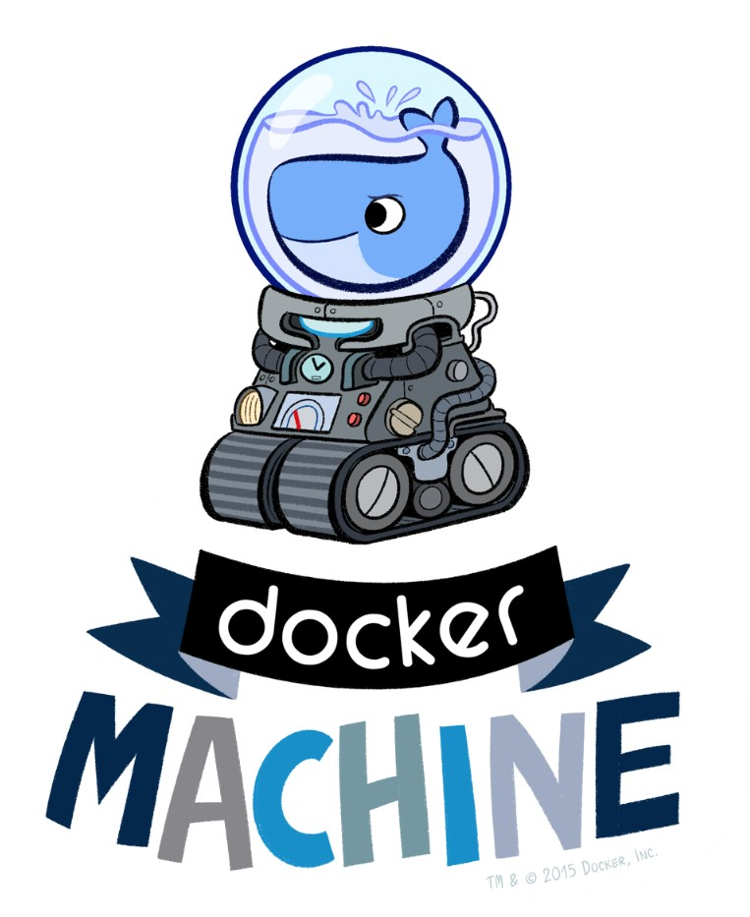
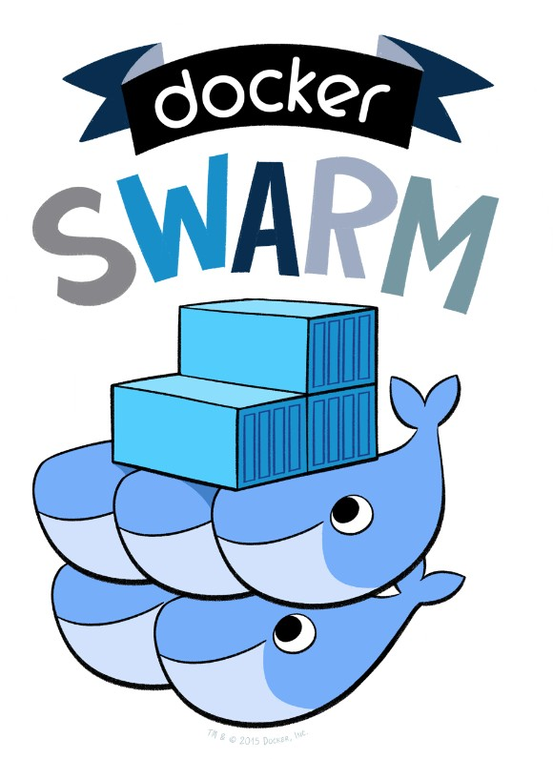
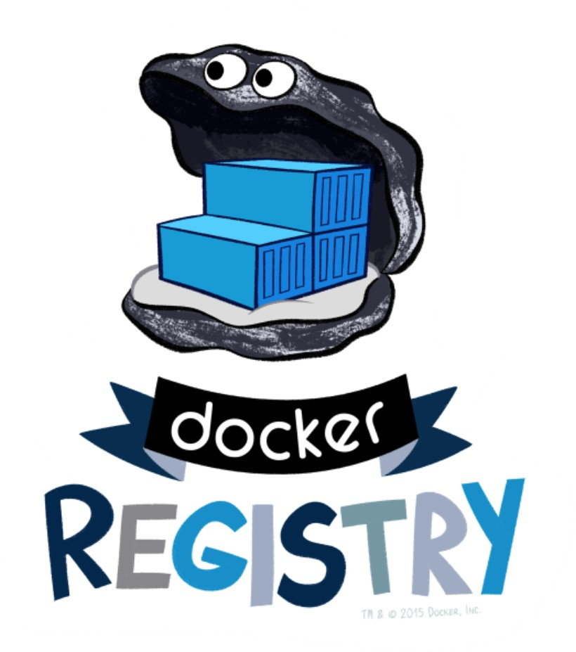
Swarm
Compose
Registry
Machine

